Slide 1

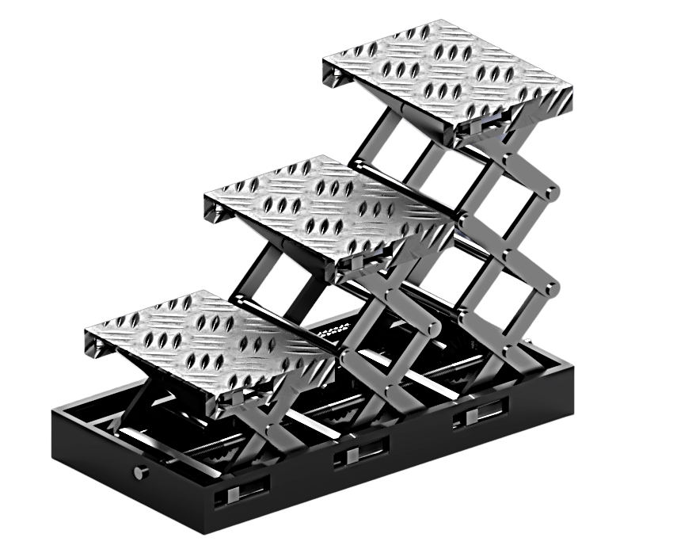
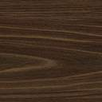
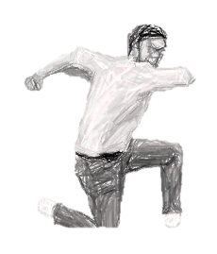
The Extendable staircase!!
…Based on the Scissors Mechanism!
We, the staircases,
Of the modern era,
Hereby solemnly declare,
That from now onwards,
We will FOREVER EXTENDDDDDDDDDDD!!!

Slide 2
Course Faculty
Course Instructor : Dr. Shashank Shekhar
Tutor : Mr. Neeraj Chawake
Teaching assistants : Mr. Sandeep Sahni & Mr. Ankush Ghosh.
Lab In-charge : Mr. Indra Pal Singh

Slide 3
Group members
Garvit Arora 200372
Jatin Chauhan 200469
Daksh Shrivastava 200304
Granth Choudhary 200392
Karan Jeyasankar 200490
Apurb Agarwal 200179
Ananya Mehrotra 200119
Muhammad Farhan 200603

Slide 4
Acknowledgement
There are a number of people without whose support the project would not have been possible. We would like to express our sincere gratitude to our Course Tutor, Dr. Niraj Chawake and lab in-charge Mr. Indra Pal Singh for their guidance and support throughout the execution of the project. We also extend our gratitude to the Teaching Assistants, Mr. Sandeep Sahni and Mr. Ankush Ghosh for providing valuable inputs. We would like to thank our Course
Instructor, Dr. Shashank Shekhar for providing us
with the opportunity to work as a team in
designing a unique product by using the theoretical
concepts learnt in class.

Slide 5
Table Of Contents
Contents | Page Number
Cover | 1
Course Faculty and Group Members | 2-3
Acknowledgment | 4
Introduction and Motivation | 6
Working principle | 7
Components and Materials Required | 8
Materials Required | 9
Processes | 10-11
Processes in Detail | 12-17
Isometric drawing of assembly | 18
Individual Components | 17-27
Sustainability Analysis | 28
Cost analysis | 29
Work Distribution and Timeline | 30-33

Slide 6
Introduction and motivation
The Extendable Staircase is a project motivated by the requirement to save the space used by staircases in homes and offices.
The Extendable Staircase has been designed such that its steps will extend out of the floor to appropriate heights using the scissors mechanism, which is driven by gear chain mechanism,
operated by a motor.
Also, we might not need any power to lower staircase. We just need
to switch off our motor and gravity will do rest of the job. A safer
and better method is explained in working mechanism.

Slide 7
Working Principle
First, a motor attached to the main gear rotates the gear at a speed controlled by the operator. Then, this rotation is transferred to 3 different shafts through a gear chain assembly. The rotation is then transferred to the main threaded shaft at the center of the contraption with the help of 3 sets of 90⁰ bevel gears. Now, the threaded shaft, which is screwed into the sliding rods, starts to rotate, and in turn pulling the sliding rod causing scissor legs to be pulled towards each other, which raises
the platform. The motor can be stopped at any time,
maintaining the platform at a constant height.
The lowering of the platform is executed by reversing the direction of the rotation of the motor which will push the arms away from each other. Furthermore, it will not rotate until its electric solenoid is activated, which prevents the sudden descent that can result from a power failure.

Slide 8
Components and materials required
Scissor Parts Mild steel flat
Platform Mild Steel Flat
Gears and Chain Iron
Shafts Mild Steel Round Rod – 10 mm
Motor Pre-fabricated
Base Frame Mild Steel Flat
Nuts and Bolts Small Nut-Bolts with mild steel washer
Joints (Bearings and pins for Scissors) Aluminium & Cast Iron
Joints (Brackets and pins for Base and Platform) Aluminium & Cast Iron

Slide 9
Materials Required
Mild Steel Flat
Mild steel flat will be used for Scissors because of its composition which gives it high strength.
Galvanized Iron Sheets
These are rust-resistant structural iron sheets which will be used to make the platforms and the base for our staircase.
Aluminum and Cast Iron
Bearings, pins and brackets will be casted using Aluminum and Cast Iron.
Iron
Iron will be used to cast gears and shafts as iron can be casted easily in any form.

Slide 10
Processes involved
Sand Mould Casting
Sand mould casting has been used to fabricate parts like nuts, bolts, chains and gears.
Extrusion
Radially symmetric products like shafts were made using Extrusion.
Cutting
Scissors’ parts were manufactured by cutting thick metal sheet into the desired shape.
Sheet Metal Bending
Metal sheets will be bent to make the platform and the base frame.

Slide 11
Continued…. Processes involved
Riveting
Riveting has been used to join the scissors so that they can freely rotate about the pivot.
Welding
Welding has been used for different static joints.
Surface treatment
Our casted parts have been galvanized to protect them from rusting.
AND NOW IN DETAIL….

Slide 12
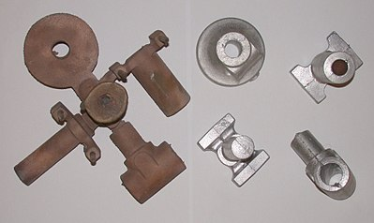
Sand Mould Casting
Sand-mold casting is a metal casting process characterized by using sand as the mold material. The term "sand casting" can also refer to an object produced via the process. A major amount of metal castings are produced using this process.
Molds are made of sand and in addition, a suitable bonding agent (usually clay) is mixed. The mixture is moistened, typically with water, but sometimes with other substances, to develop the strength and plasticity of the clay. The sand is contained in a system of frames known as a flask. The mold cavities and gate system are created by compacting the sand around models called patterns, by carving directly into the sand.
Molten metal is then poured into the mold cavity and we get the required product upon cooling and some additional finishing.

Slide 13
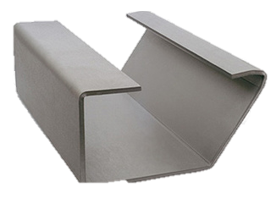
Sheet metal bending
Bending is a manufacturing process that is used to produce
a U-shaped, V-shaped or channel shape along a straight
axis in ductile materials, most commonly sheet metals.
Sheet metal bending can be done with help of the metal
bending machine, which has box, pan brakes and
brake presses and other specialized machine presses.
It will be used for making the platforms and the
base for our staircase.

Slide 14
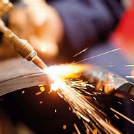
Cutting
Cutting has been at the core of manufacturing throughout history.
Different methods are used for cutting metals which can be grouped by the physical phenomena used.
The process involves removing unwanted material
from a block of metal in form of chips to get our
desired product.
This will be used for different parts including
scissors, base and platform.

Slide 15
Welding
.
.
Welding is a fabrication process that joins materials, usually metal and thermoplastics.
It is done by heating the parts to a high temperature and allowing them to cool while in contact, causing fusion.
In this process, the base metal is
melted to form a strong joint between
parts, unlike in the brazing and
soldering processes in which the
base metal is not melted.

Slide 16

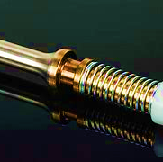






Riveting
A rivet is a permanent mechanical fastener which is used to join
two parts which can freely rotate about the rivet.
It consists of a smooth cylindrical shaft with a head on one end.
The end opposite to head is called tail.
The rivet is placed in a punched or drilled hole, and
the tail is bucked so that it expands to about 1.5 times
the shaft diameter holding the rivet in place.
We will use riveting for the joining the scissors’
parts together.

Slide 17
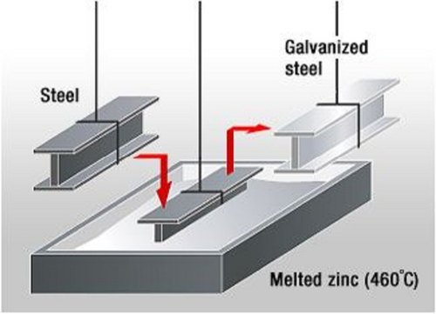

Galvanization
It is the process of coating the surface of the parts
made up of iron or steel with a protective layer of
zinc in order to prevent the part from rusting and increase its durability.
The method to be used is hot dip galvanization, in which the parts are
dipped in the hot molten zinc and upon colling,
the protective layer of zinc is formed on it.

Slide 18
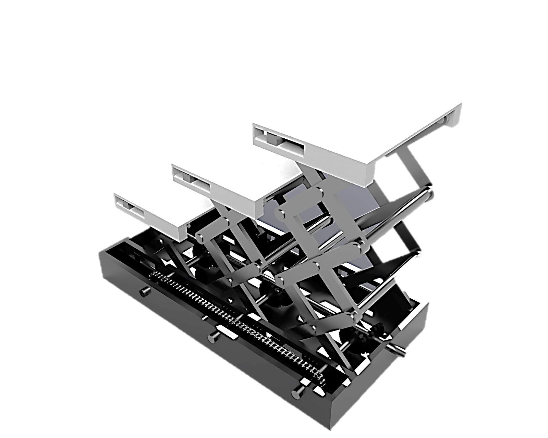
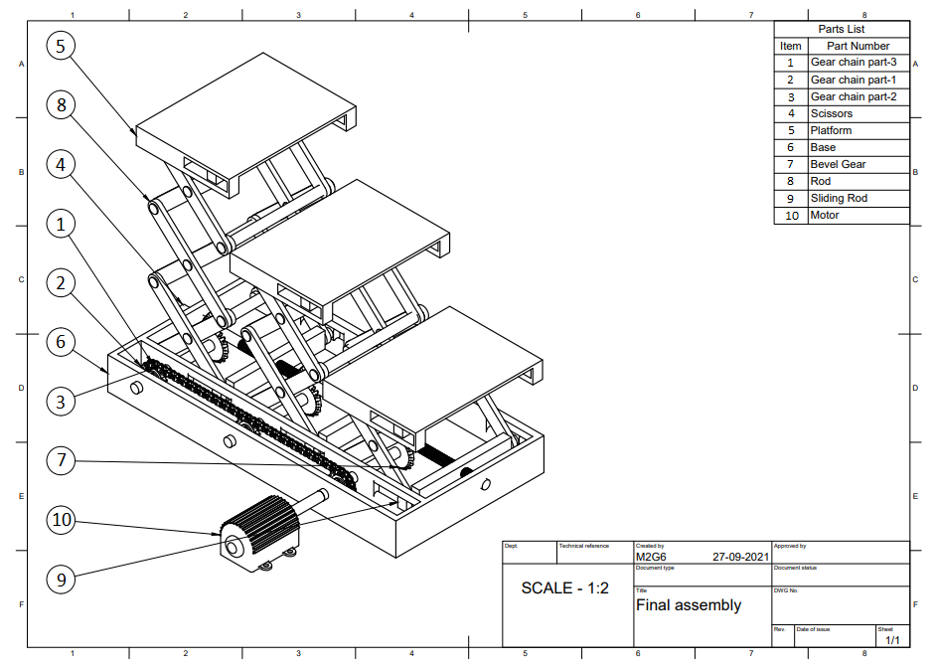
Isometric drawing
INDIVIDUAL COMPONENTS….

Slide 19
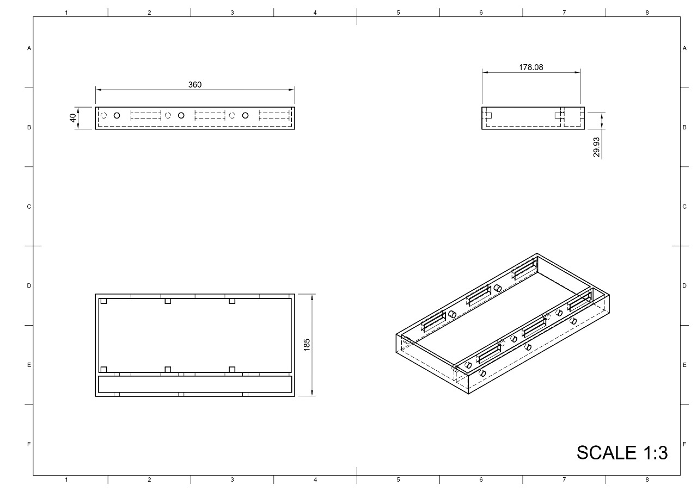
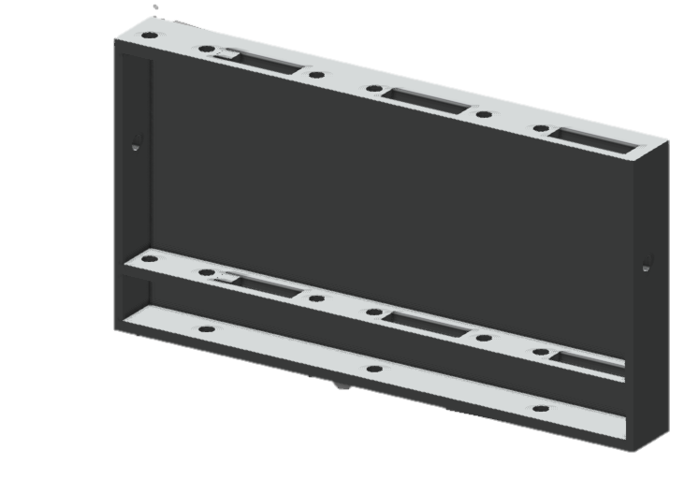
Base
NOTE: All dimensions are in mm.
Processes : Sheet Metal Bending, Welding and Cutting
Material Required : Mild Steel Sheet

Slide 20
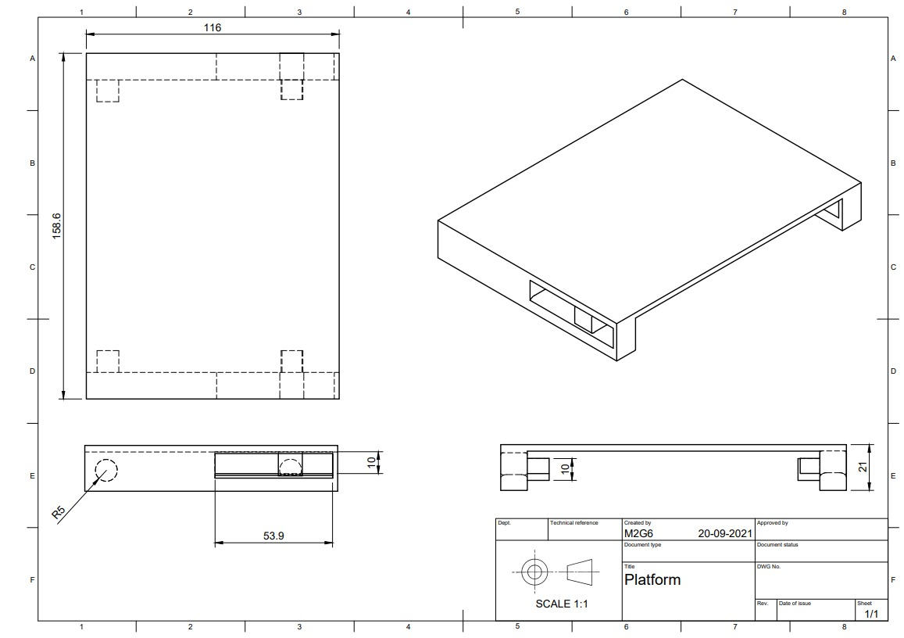
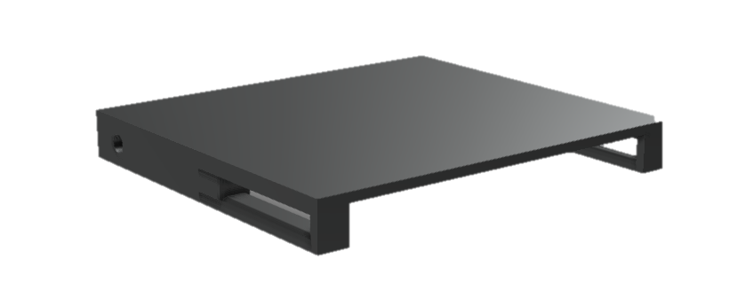
Platform
NOTE: All dimensions are in mm.
Processes : Sheet Metal Bending, Welding and Cutting
Material Required : Mild Steel Sheet

Slide 21
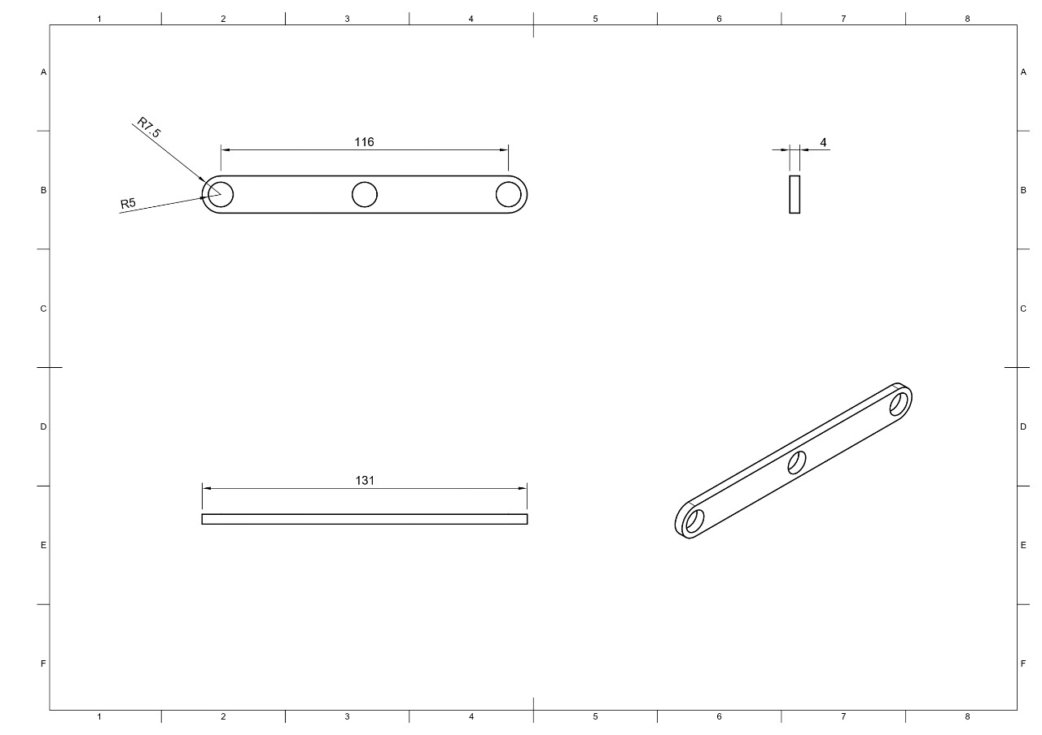
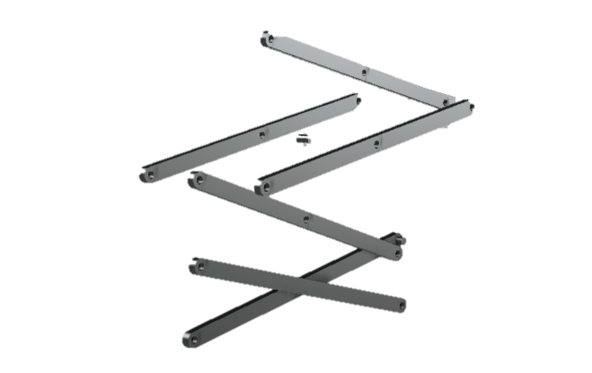
Scissors
NOTE: All dimensions are in mm.
SCALE 1:3
Processes : Cutting and Riveting
Material Required : Mild Steel Flat

Slide 22
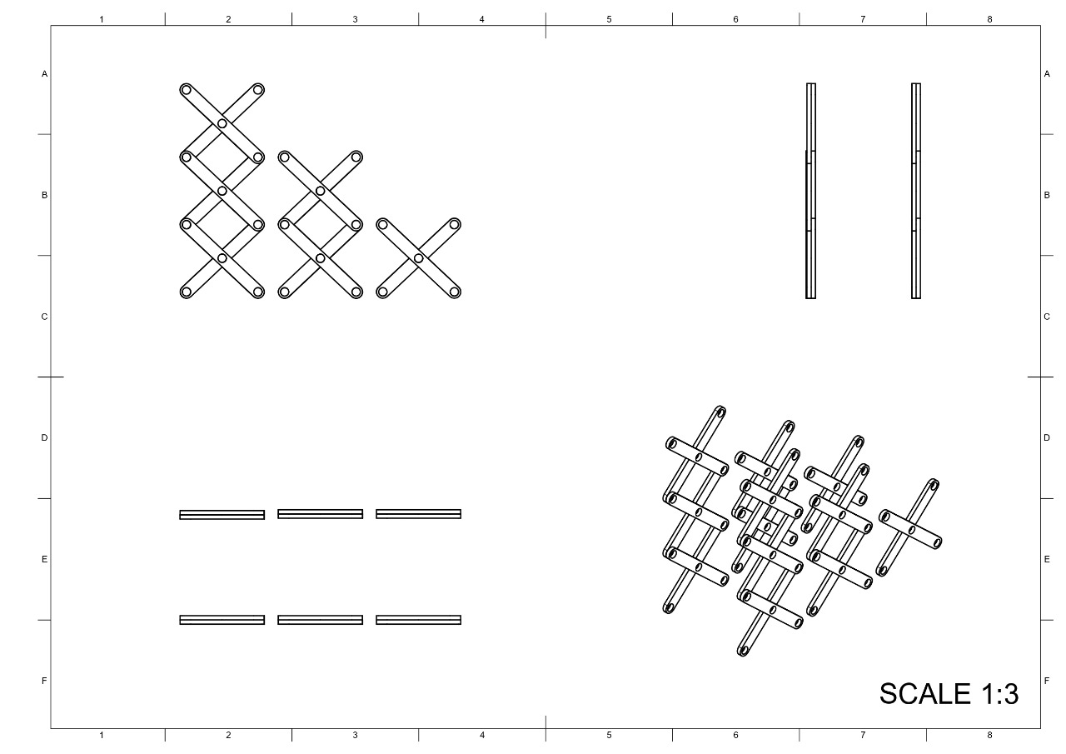
continued…. Scissors
NOTE: All dimensions are in mm.
Processes : Cutting and Riveting
Material Required : Mild Steel Flat

Slide 23
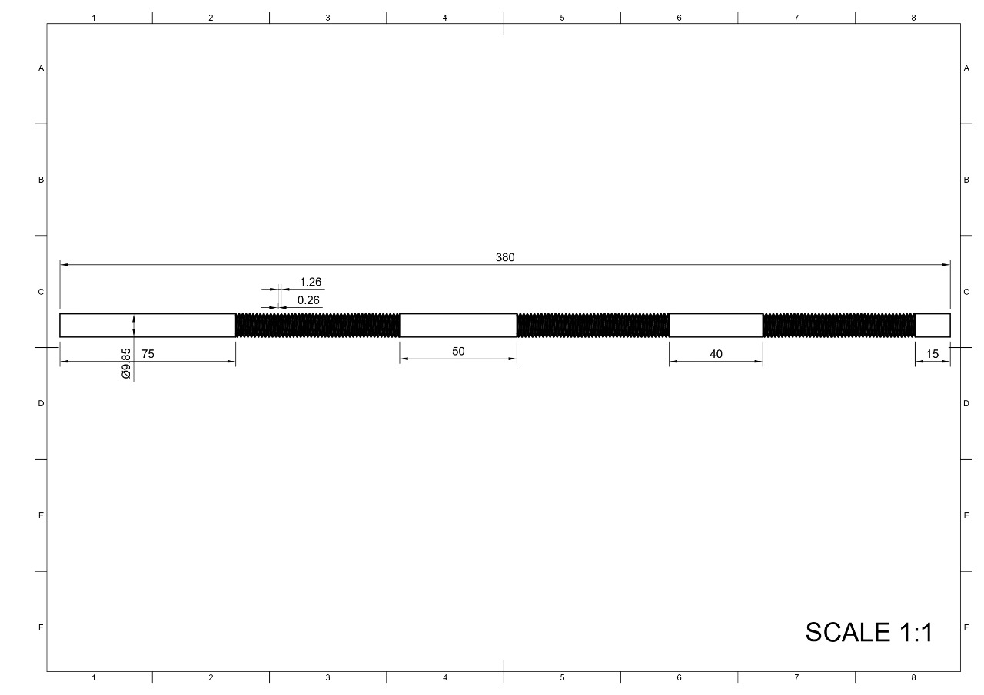
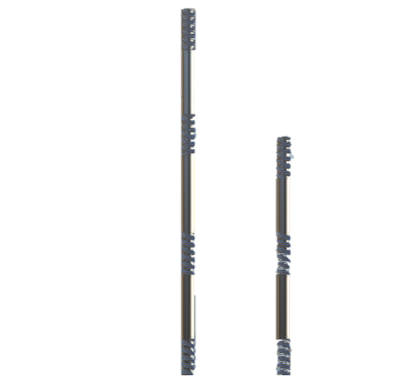
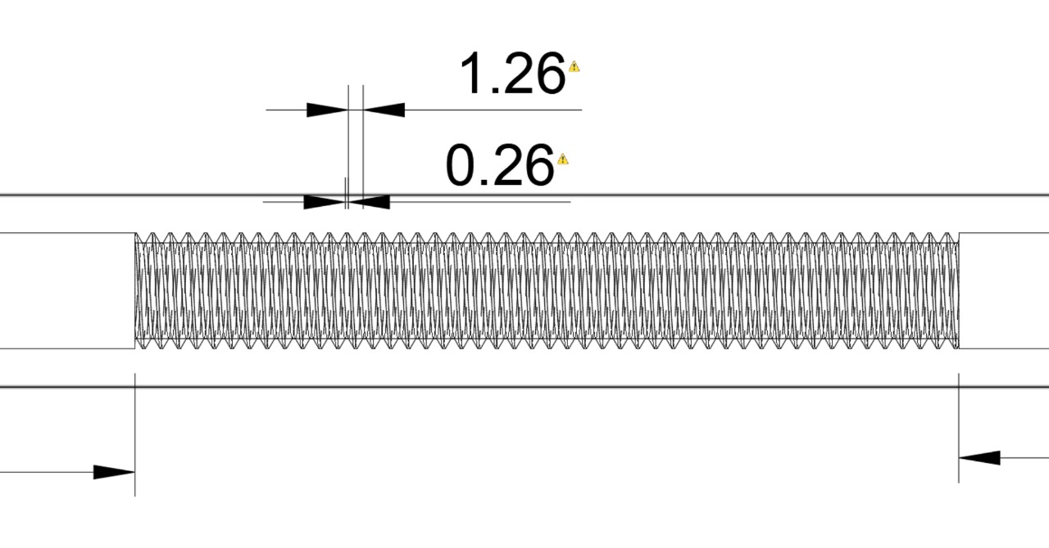
Shafts
NOTE: All dimensions are in mm.
Processes : Extrusion and Threading
Material Required : Mild Steel Round Rod

Slide 24
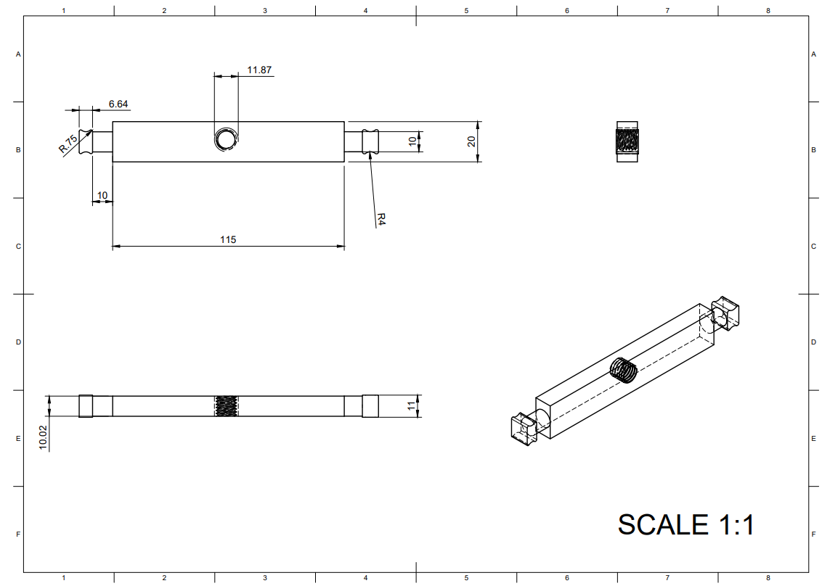
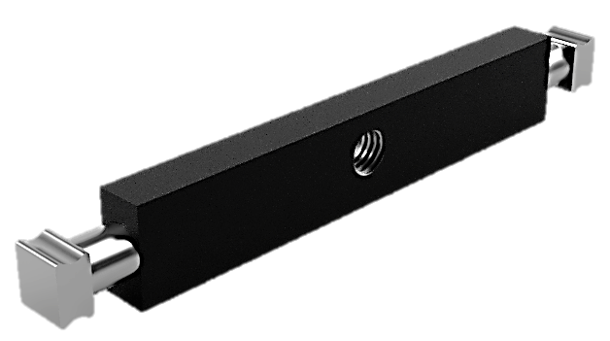
Sliding rod
NOTE: All dimensions are in mm.
Processes : Casting, Welding, and Threading
Material Required : Mild Steel Square Rod and cast iron

Slide 25
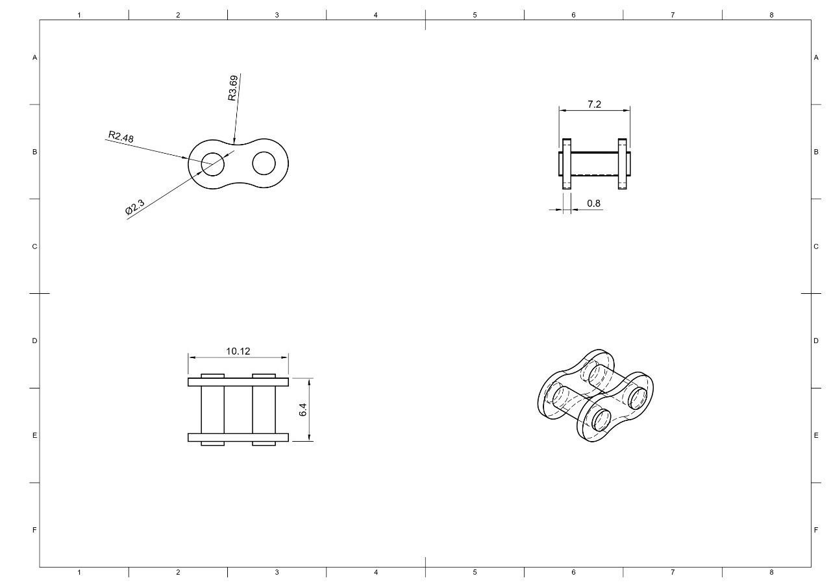
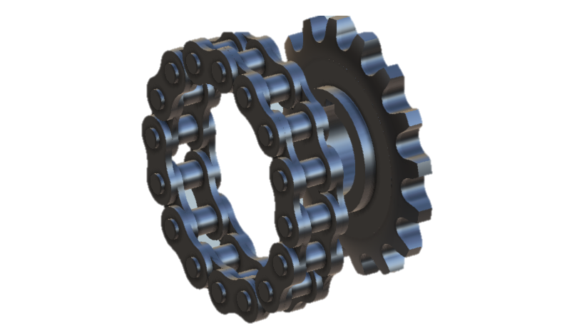
Gears and chain
NOTE: All dimensions are in mm.
SCALE 3:1
Processes : Sand Mould Casting and Galvanization
Material Required : Cast Iron

Slide 26
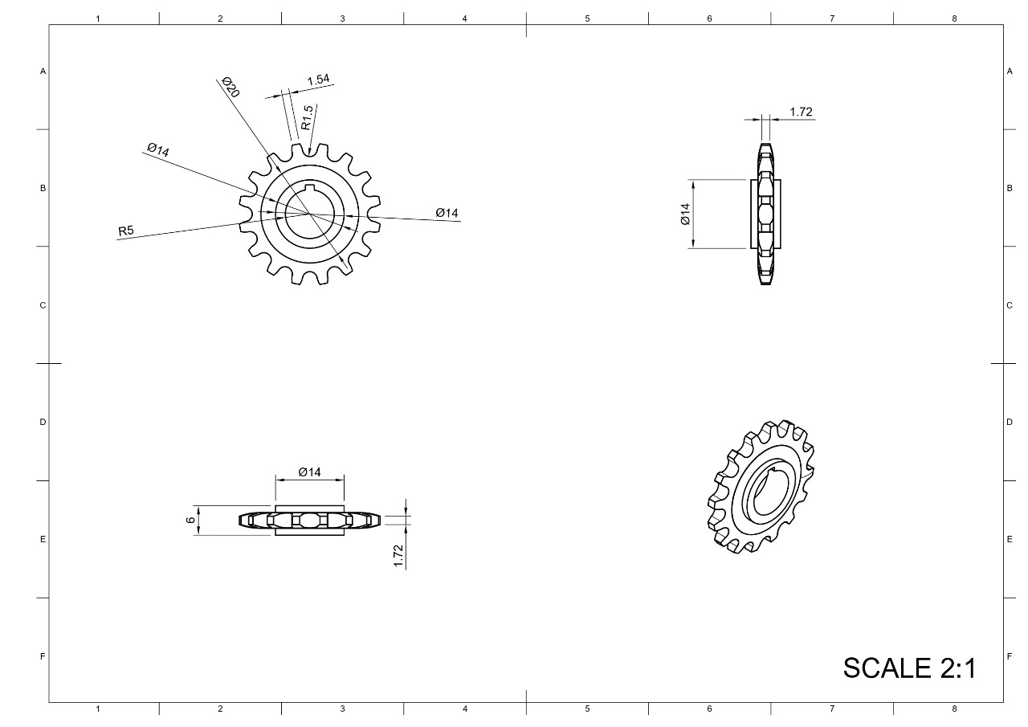
continued…. Gears and chain
NOTE: All dimensions are in mm.
Processes : Sand Mould Casting and Galvanization
Material Required : Cast Iron

Slide 27
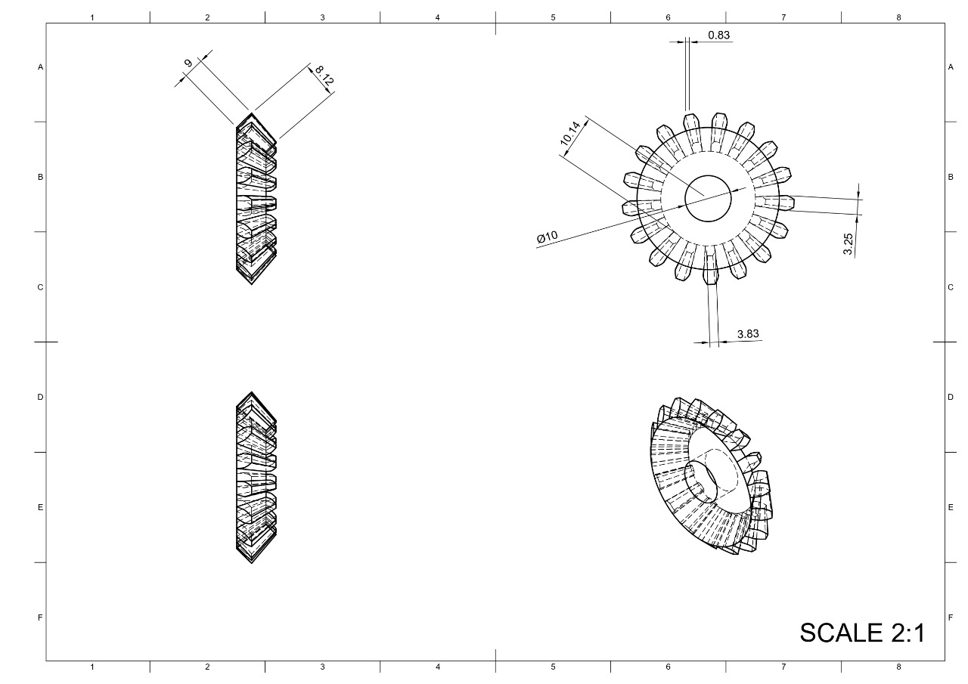
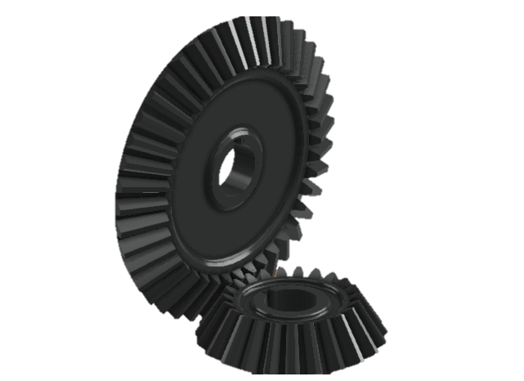
bevel Gear
NOTE: All dimensions are in mm.
Processes : Investment Casting and Galvanization
Material Required : Cast Iron

Slide 28
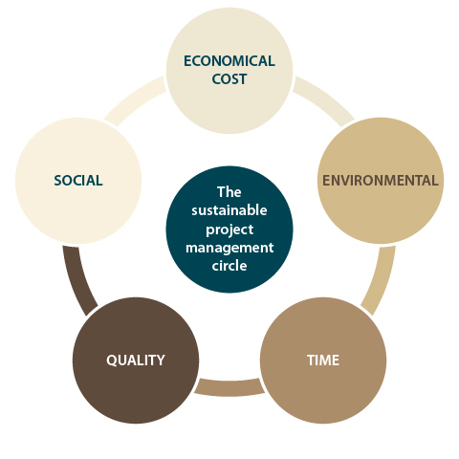
Sustainability
Social :
The whole idea behind this project is to save space. Also, it is very simple and easy to use.
Durability :
The parts which could rust, have been galvanized giving strength and durability to the model, increasing its life.
Recyclable :
All the parts used are easily recyclable and can be used again.
Portability :
The whole model is fully portable and can be easily installed anywhere.
Economical :
Economic cost has been kept in mind while designing the model. It is relatively cheap compared to its utility and quality.

Slide 29
Cost analysis
Parts(Qty.) | Material | Total cost of each part
Platform(*3) | Mild Steel Flat | 150.15
Arm(*24) | Mild Steel Flat | 102.96
Long Shaft(*1) | Mild Steel Round Rods | 14.07
Base(*1) | Mild Steel Flat | 319.41
Sprocket(*3) | Cast Iron | 2.6
Chain Links(*62) | Mild Steel Flat | 3.5
Chain Links (inner)(*62) | Mild Steel Flat | 2.34
Bevel Gear(*6) | Cast Iron | 13.5
Rods Sliding(*3) | Mild Steel Square Rods | 45
Small Rods(*3) | Mild Steel Round Rods | 23.86
Total = 677.39 | ROUNDING OFF COST CONSIDERING WASTAGE = 740

Slide 30
Timeline
Week 1:
Initial Ideation : Shortlisting 3 ideas from which we choose one to work with.
Week 2:
Solidification of the Project idea and further planning.
Week 3 & 4:
Division of work between team members.
Designing individual parts and creating their isometric drawings.
Week 5 (Finale):
Compilation of the drawings and content in a Power Point Presentation.

Slide 31
Work Distribution
NAME | Turn 1 | Turn 2 | Turn 3 | Turn 4 | Turn 5 | Turn 6
Garvit Arora | Ideation (Staircase) | Finalizing Working mechanism | Designing Shafts | Finalized the design and Made drawings of shafts and Draft presentation | Compilation and overall PPT Design | Final Project Report and Presentation
Karan Jeyasankar | Ideation (Bicycle Cleaner) | Finalizing Working mechanism | Designing Scissors | Finalized the design and Made drawings of scissors | Compilation and Sustainability analysis | Final Project Report and Presentation
Apurb Agarwal | Ideation (Staircase) | Finalizing Working mechanism | Designing Base | Finalized the design and Made drawing of base | Compilation and Draft Report | Final Project Report and Presentation

Slide 32
Work Distribution
NAME | Turn 1 | Turn 2 | Turn 3 | Turn 4 | Turn 5 | Turn 6
Granth Choudhary | Ideation (staircase) | Finalizing Working mechanism | Designing Gears and Chains | Finalized the design and Made drawings of gears | Compilation and Cost Analysis | Final Project Report and Presentation
Jatin Chauhan | Ideation (Bicycle Cleaner) | Finalizing Materials required | Designing Platform | Finalized the design and Made the Draft presentation | Cost Analysis and PPT Design | Final Project Report and Presentation
Daksh Shrivastava | Ideation (Robotic Arm) | Finalizing Materials required | Designing Gears and Chains | Finalized the design and Made drawings of chains | Cost Analysis and PPT Design | Final Project Report and Presentation

Slide 33
Work Distribution
NAME | Turn 1 | Turn 2 | Turn 3 | Turn 4 | Turn 5 | Turn 6
Ananya Mehrotra | Ideation (Robotic Arm) | Finalizing Working mechanism | Designing Platform | Finalized the design and Made drawing of platform | Compilation and Process Description | Final Project Report and Presentation
Muhammad Farhan | Ideation (Bicycle Cleaner) | Finalizing Materials required | Designing Scissors | Finalized the design and Made the Draft presentation | Sustainability analysis and Process Description | Final Project Report and Presentation

Slide 34

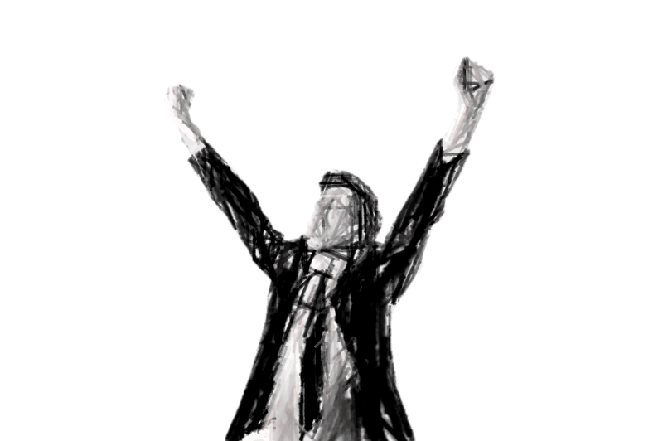
The end
Thank You!!!

